Slide 1


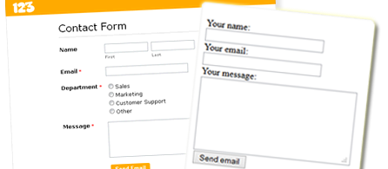

HTTP, HTML and PHP
SoftUni Team
Technical Trainers
Software University
http://softuni.bg

Slide 2
Questions
sli.do #PHP-WEB

Slide 3

Table of Contents
HTTP
Request Methods
HTML Basic
HTML Forms
Elements

Slide 4
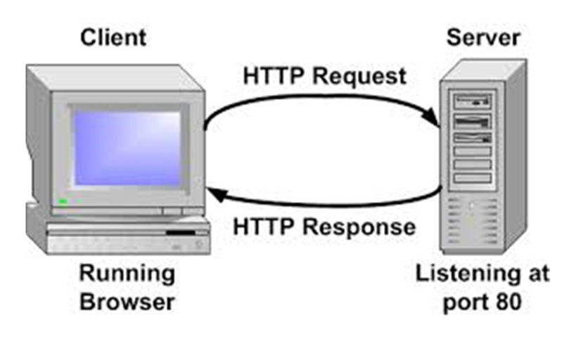
HTTP
How Browsers talk with Servers?

Slide 5
Big Picture
HTTP
FILE
TCP/Socket
Server
Internet
DB
Browser
Web Server
PHP
DB Client

Slide 6
What is HTTP
HyperText Transfer Protocol
Main protocol for WEB communication
Base on client-server principe
Text based - easy to read, easy to debug
Use request/response principe

Slide 7
Web Page Loading
Browser
Server
PHP
index.php
Web Server
HTML
image.jpg
File System
IMAGE
style.css
STYLE

Slide 8
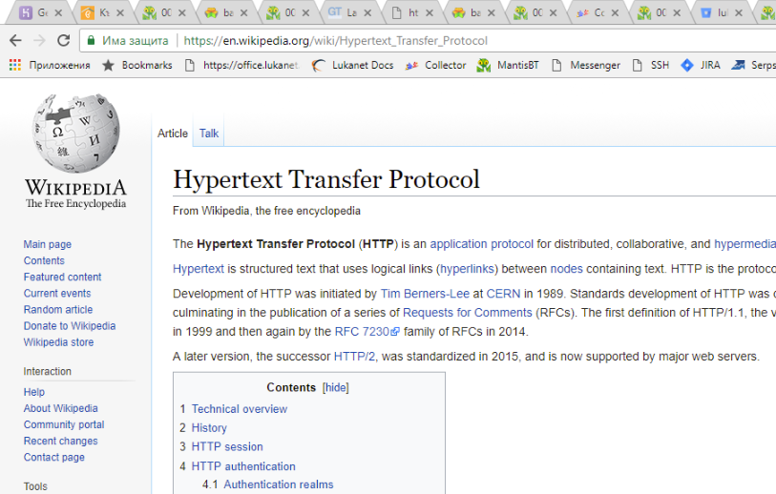
Web Page Loading
Browser
Server
PHP
Web Server
File System

Slide 9
Tools for “listening” HTTP
Browsers Dev Tools
Fiddler - https://www.telerik.com/fiddler
TCP/IP sniffers

Slide 10
HTTP parts
Headers
system information
Body
useful information
Delimiter is first empty line
Exists both in request and in response

Slide 11
HTTP Request
GET /edit.php?id=5 HTTP/1.1
Host: abv.bg
User-Agent: Mozilla/5.0 (Windows; U; Windows NT 6.1; enUS; rv: 1.9.1.5) Gecko/20091102 Firefox/3.5.5
Accept: text/html,application/xhtml+xml,application/xml
Accept-Language: en-us,en Accept-Charset: UTF-8

Slide 12
HTTP Response Header
HTTP/1.1 200 OK
Date: Mon, 23 May 2005 22:38:34 GMT
Server: Apache/1.3.3.7 (Unix) (Red-Hat/Linux)
Last-Modified: Wed, 08 Jan 2003 23:11:55 GMT
ETag: "3f80f-1b6-3e1cb03b"
Content-Type: text/html; charset=UTF-8
Content-Length: 138 Accept-Ranges: bytes
Connection: close

Slide 13
HTTP Response Body
<html> <head> <title>An Example Page</title> </head> <body> Hello World, this is a very simple HTML document. </body> </html>

Slide 14
HTTP Methods
GET
POST
HEAD
PUT
DELETE
CONNECT
OPTIONS

Slide 15
HTTP Status codes
1xx - Informations
2xx - Success
3xx - Redirects
4xx - Client errors
5xx - Server errors

Slide 16
Popular HTTP Codes
200 ОК
404 Not Found
301 Moved Permanently
304 NotModified
500 Server Error

Slide 17

HTTP Headers
Live Demo

Slide 18

HTML

Slide 19
What is HTML
<!DOCTYPE HTML>
<html>
<head>
<title>Title of the document</title>
</head>
<body>
The content of the document......
</body>
</html>

Slide 20
Populat HTML tags
Structured
H1, H2, H3,...
DIV, SPAN, P
TABLE, TR, TD
IMG, SCRIPT, STYLE
UL, OL
ARTICLE, NAV,
Interactive
A
FORM - INPUT, SELECT, BUTTON, ...

Slide 21
HTML + PHP Basic
<!DOCTYPE HTML>
<html>
<head>
<title>Title of the document</title>
</head>
<body>
<?php echo “<h1>Hello from PHP</h1>”; ?>
</body>
</html>

Slide 22

Working with Forms

Slide 23
<form>
First name:<br>
<input type="text" name="firstname"><br>
Last name:<br>
<input type="text" name="lastname">
</form>

Slide 24
Form Elements
INPUT
text, checkbox,
color, date, datetime, datetime-local, email, month, number
range
TEXTAREA
FILE
SELECT

Slide 25
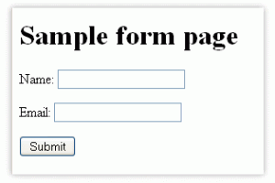
HTML Form DEMO

Slide 26








Working with Forms
https://softuni.bg/courses/php-basics/

Slide 27
License
This course (slides, examples, demos, videos, homework, etc.) is licensed under the "Creative Commons Attribution-NonCommercial-ShareAlike 4.0 International" license
Attribution: this work may contain portions from
"PHP Manual" by The PHP Group under CC-BY license
"PHP and MySQL Web Development" course by Telerik Academy under CC-BY-NC-SA license

Slide 28





Free Trainings @ Software University
Software University Foundation – softuni.org
Software University – High-Quality Education, Profession and Job for Software Developers
softuni.bg
Software University @ Facebook
facebook.com/SoftwareUniversity
Software University @ YouTube
youtube.com/SoftwareUniversity
Software University Forums – forum.softuni.bg

